Slide 1
UNINETT eCampus – building a national infrastructure for end-user services
Thorleif Hallén - UNINETT

Slide 2
About UNINETT
The research and education network of Norway

Slide 3
UNINETT eCampus – end-user services
A programme funded by the ministry of education
9 M Euros over 5 Years
In cooperation with higher education
Working groups for knowledge sharing
Best practice
Notes:
How we work
Funding

Slide 4
Available services
Lecture Capture
Techsmith Relay
Mediasite
Collaboration
Adobe Connect
FileSender
Box
Notes:
Del inn i lecture capture, collaboration, Digital assessment

Slide 5
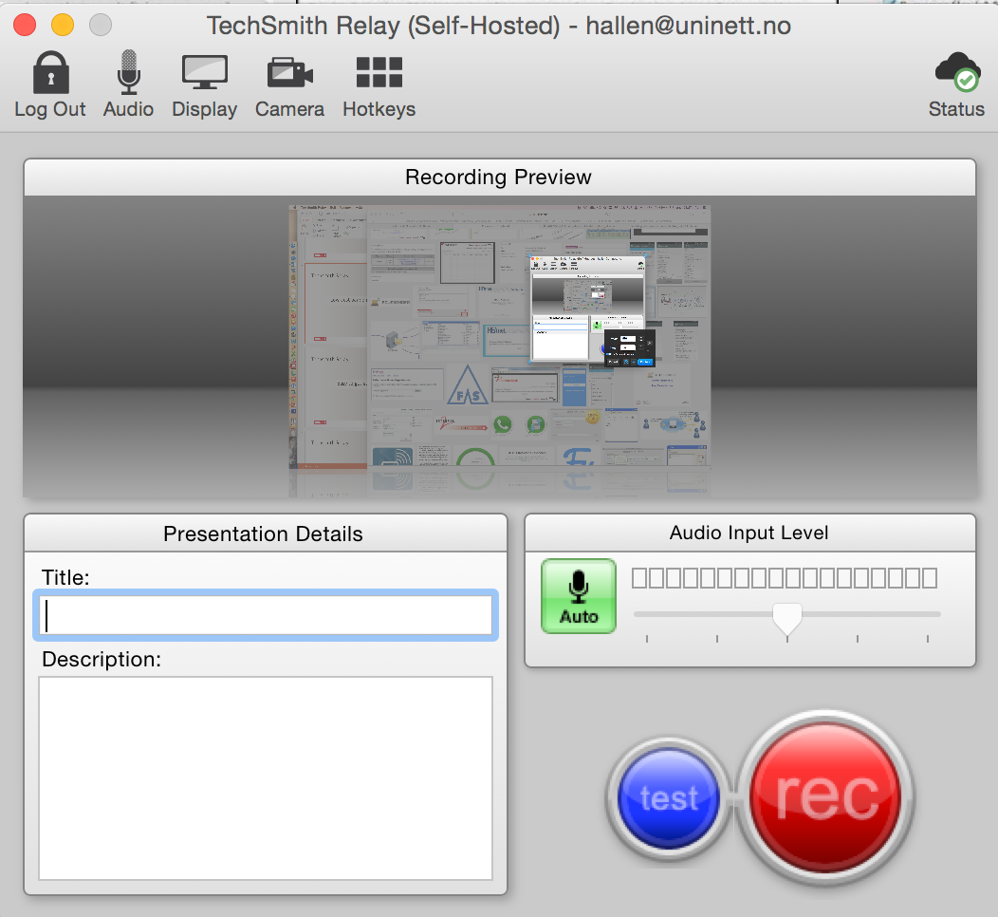
Techsmith Relay
Low cost academic video
Notes:
Supports flipped classrooom
Easy to get started

Slide 6
Techsmith Relay
Easy to get started
Notes:
Supports flipped classrooom
Easy to get started

Slide 7
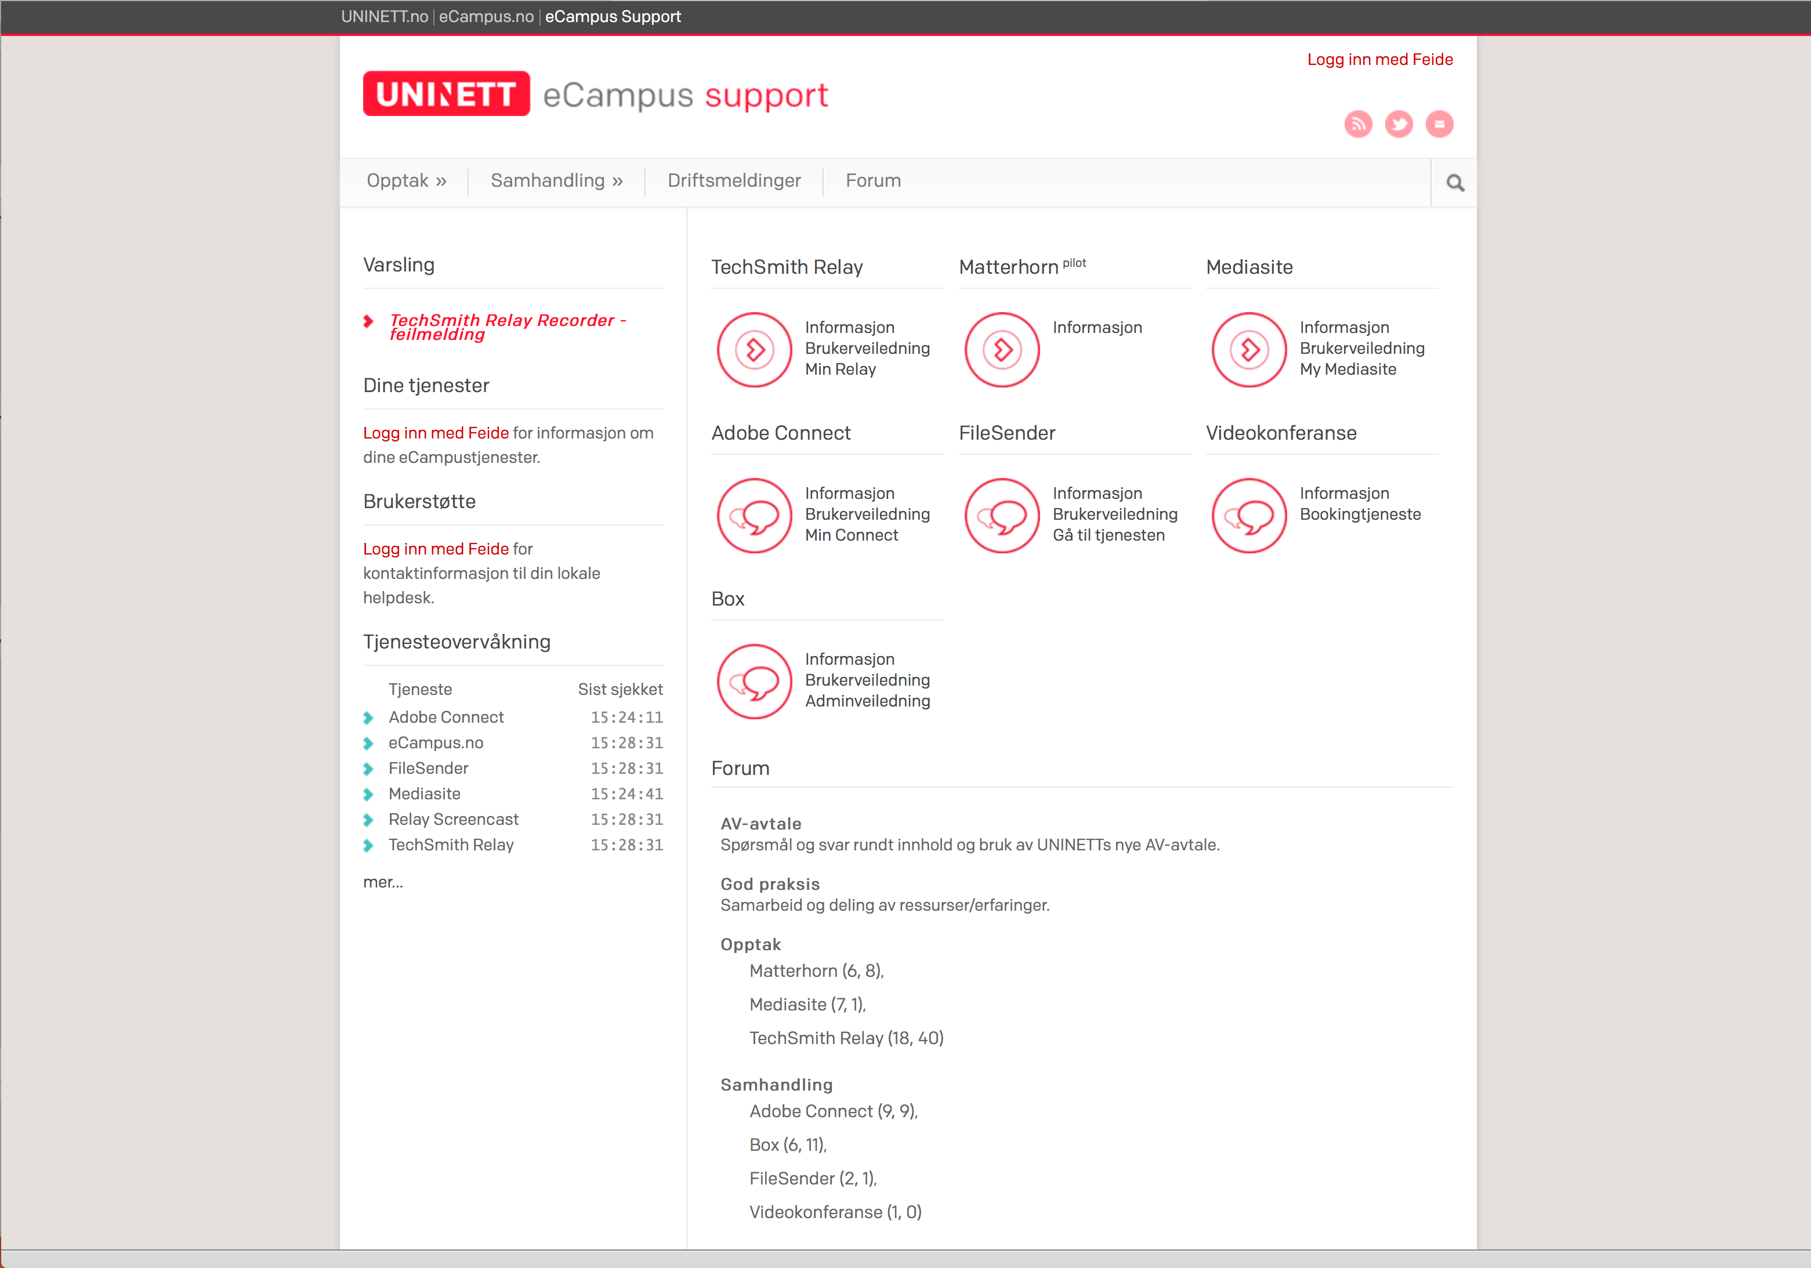
Techsmith Relay
Sett inn support.ecampus.no her
Notes:
Supports flipped classrooom
Easy to get started

Slide 8
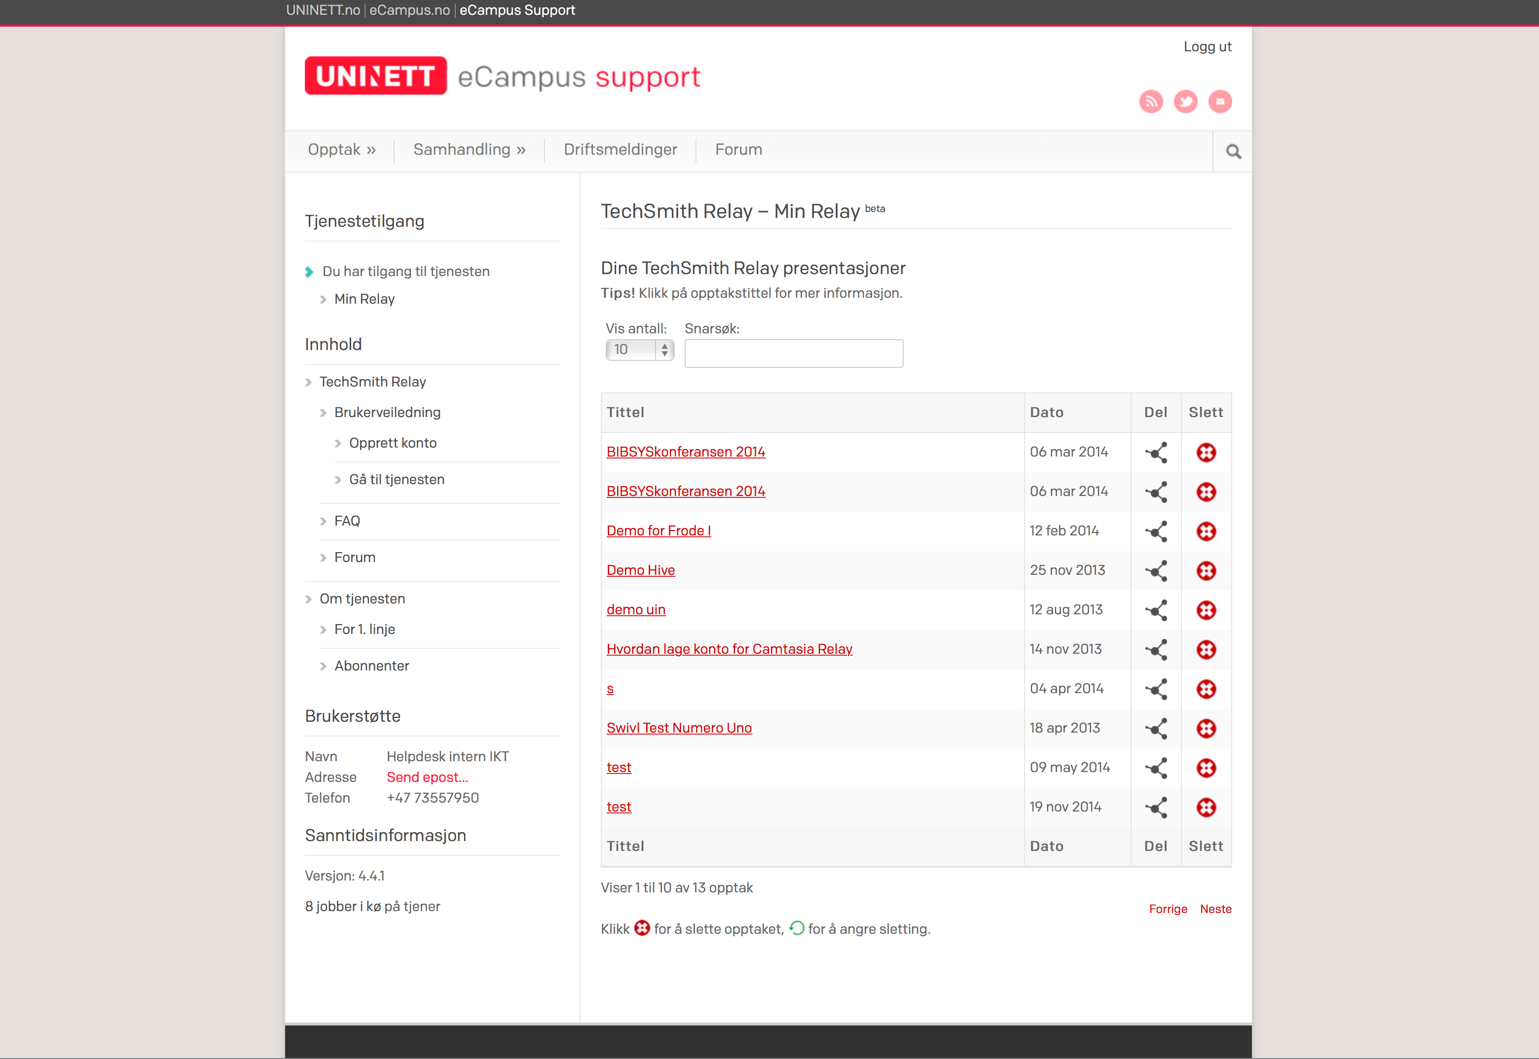

Slide 9
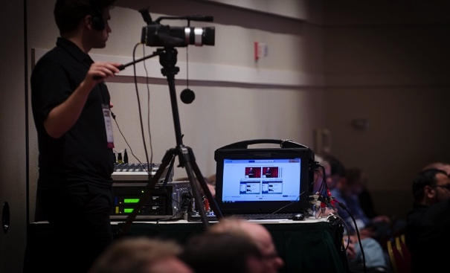
Mediasite
High end academic video
Notes:
Feide – authentication
Publishing to You Tube
Video portal

Slide 10
Mediasite
Classrooms
Notes:
Supports flipped classrooom
Easy to get started

Slide 11
Mediasite
Sett inn skjermdump her
Notes:
Feide – authentication
Publishing to You Tube
Video portal

Slide 12
Mediasite
My Mediasite – personal recordings
Notes:
Full control
Analytics
edititing

Slide 13
Mediasite
Sett inn skjermdump her
Notes:
Feide – authentication
Publishing to You Tube
Video portal

Slide 14
Mediasite
Scaling it up - Schedulator
Notes:
Full control
Analytics
edititing

Slide 15
Box
Enterprise personal file sharing
Notes:
Supports flipped classrooom
Easy to get started

Slide 16
Box
Norwegian data processing agreement
Notes:
Supports flipped classrooom
Easy to get started

Slide 17
Box
”Unlimited” storage
Notes:
Supports flipped classrooom
Easy to get started

Slide 18
Box
Access from every device
Notes:
Supports flipped classrooom
Easy to get started

Slide 19
Box
Authentication with Feide
Notes:
Supports flipped classrooom
Easy to get started

Slide 20
Adobe Connect
Web based collaboration
Notes:
Supports flipped classrooom
Easy to get started

Slide 21
Adobe Connect

Slide 22
FileSender
Fast and secure transfer of large files
Notes:
Supports flipped classrooom
Easy to get started

Slide 23
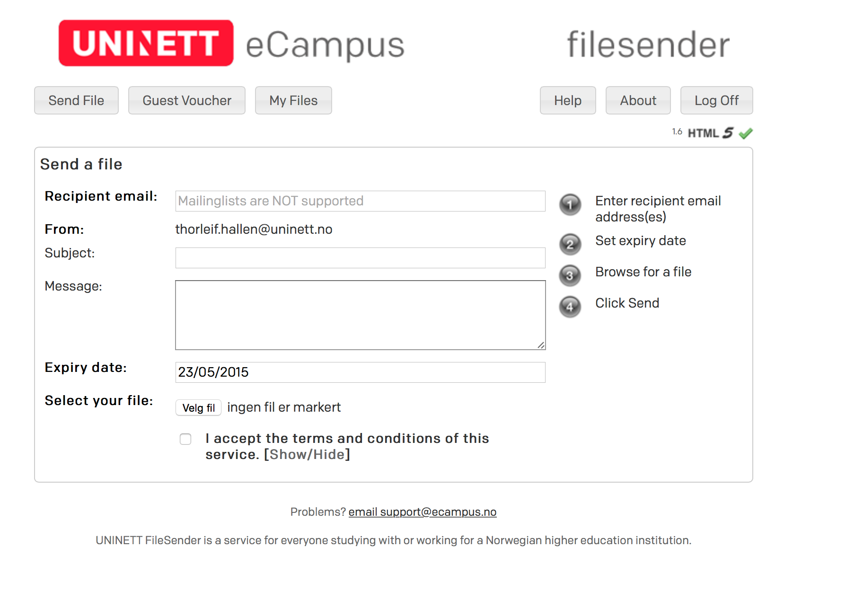
FileSender
Notes:
Supports flipped classrooom
Easy to get started

Slide 24
FileSender
Feide for authentication
Notes:
Supports flipped classrooom
Easy to get started

Slide 25
Digital Assesment
Joint effort
Notes:
Supports flipped classrooom
Easy to get started

Slide 26
Frame work agreement for AV
17 M. Euros first year
Notes:
Standardization
Best practice

Slide 27
Status
5 services introduced
Wide spread use
Standardization
Shared procurement – huge savings
........Success?

Slide 28
How did we get there?
We worked together
Notes:
Standardization
Best practice

Slide 29
How did we get there?
Shared knowledge
Notes:
Standardization
Best practice

Slide 30
How did we get there?
Shared best practice
Notes:
Standardization
Best practice

Slide 31
How did we get there?
Shared resources
Notes:
Standardization
Best practice

